Slide 1
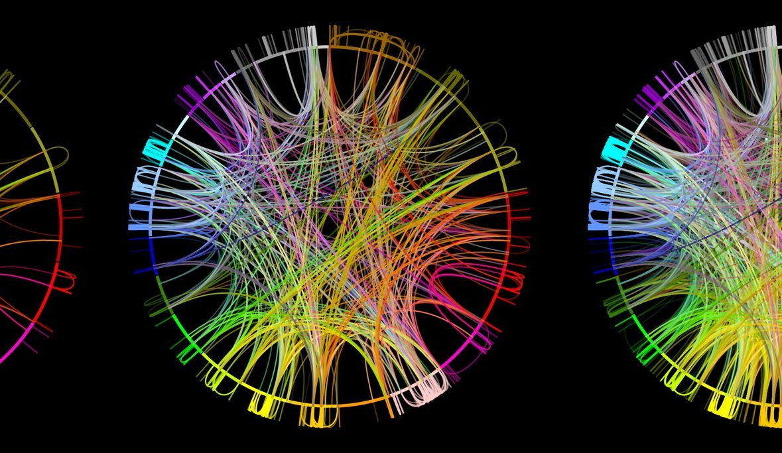



Systems Biology of Human Metabolism and Gut Microbiome
Metabolomics
Data Generation and Analysis
Dr. Abdellah TEBANI
KTH - Stockholm – 1st October 2018

Slide 2
Learning Objectives
You will learn about
Metabolomics / Targeted and Untargeted
Analytical technologies
Main processing pipelines
Univariate statistics
Multivariate statistics
Machine learning - Unsupervized / Supervized
Clustering
PCA
PLS-DA
Tips, pitfalls and traps

Slide 3
Outline
Part I - Getting the biological information
Experimental Design
Data Generation / Analytical technologies
Preprocessing
Data cleaning
Part II – Machine Learning and Data Analysis
Univariate vs Multivariate
What is meachine learning
Unsupervized learning
Supervized learning
Key steps and best practice

Slide 4
Outline
Part I - Getting the biological information
Experimental Design
Data Generation / Analytical technologies
Preprocessing
Data cleaning
Part II – Machine Learning and Data Analysis
Univariate vs Multivariate
What is meachine learning
Unsupervized learning
Supervized learning
Key steps and best practice

Slide 5
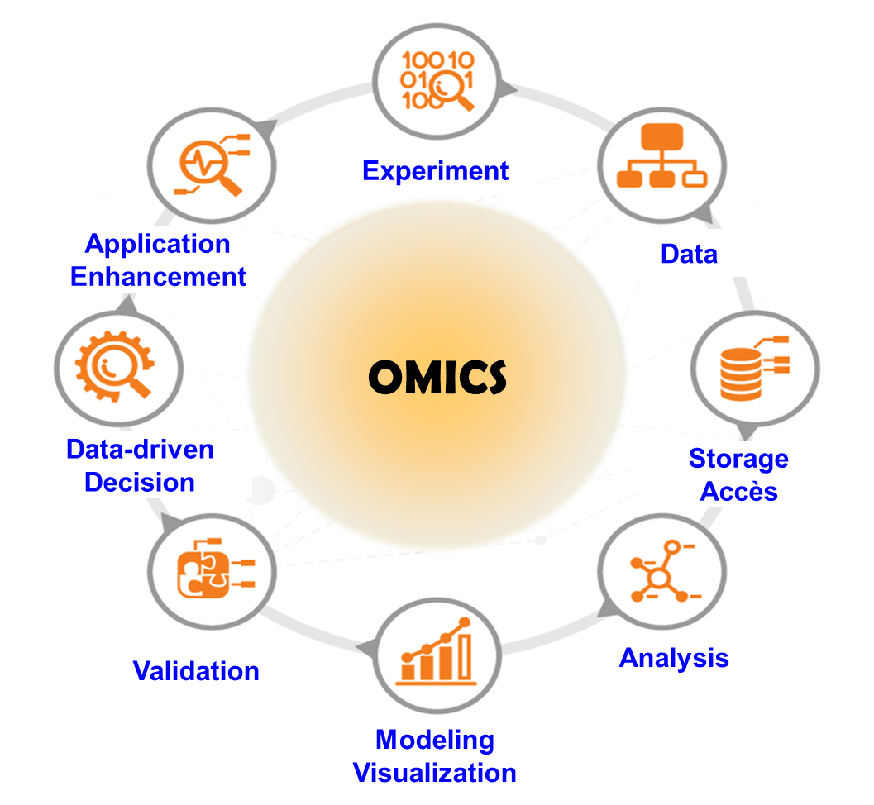
Biological Information Generation

Slide 6
Experimental Design may help
Clear and precise study objective
Sample type and size
Sampling and sample preparation strategy
Number of samples / Biological - Analytical replicates
Analytical technology(ies)
Collection of meta-data (Categorical, continuous, ordinal…)
Confounding factors
Randomization
Data analysis strategies (univariate vs. multivariate)
Biological Interpretation and insights
Validation (Biological/Analytical)
…Name it

Slide 7
Know your data
QUANTITATIVE
Discrete
Continuous
QUALITATIVE
Binary
Nominal
Ordinal

Slide 8
Metabolomics
What can happen
Genomics
DNA
What appears to be happening
Transcriptomics
RNA
What makes it happen
Proteomics
Proteins
What has happened and is happening
Metabolites
Amino acids, sugars, nucleotides lipids (Lipidome)
Metabolomics

Slide 9
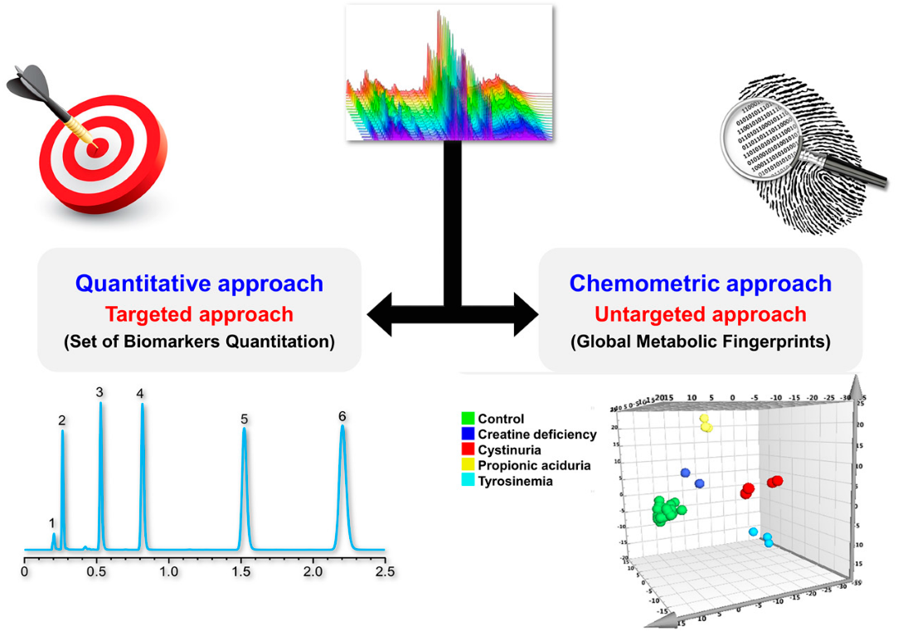
Metabolomics
Tebani et al. IJMS. 2016

Slide 10

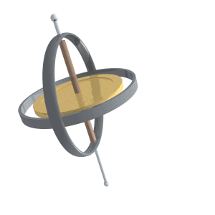

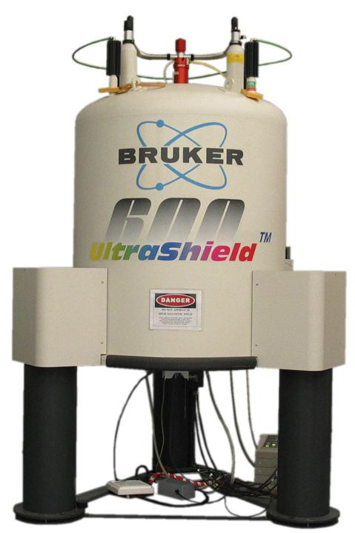
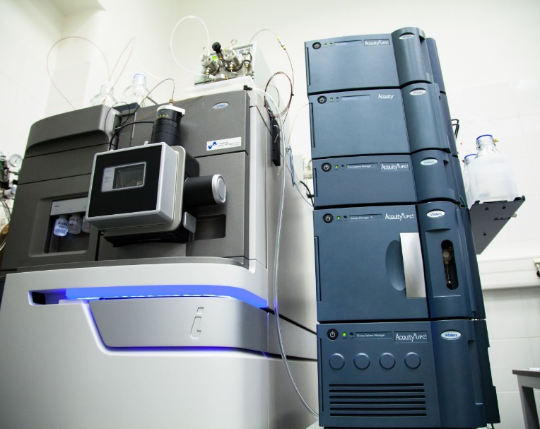
Biological Information Extraction
NMR spectroscopy
Mass spectrometry

Slide 11
Biological Information Extraction
NMR spectroscopy
Mass spectrometry
Tissues, biofluids and extracts
Tissues, biofluids and extracts
Interaction of spin active nuclei (¹H, ¹³C, ³¹P) with electromagnetic fields gives molecular information
Mass to charge ratio (m/z)
Non-destructive
Cross-instrument robustness
Sensitivity
Higher metabolome coverage
Tebani et al. JIMD. 2016

Slide 12
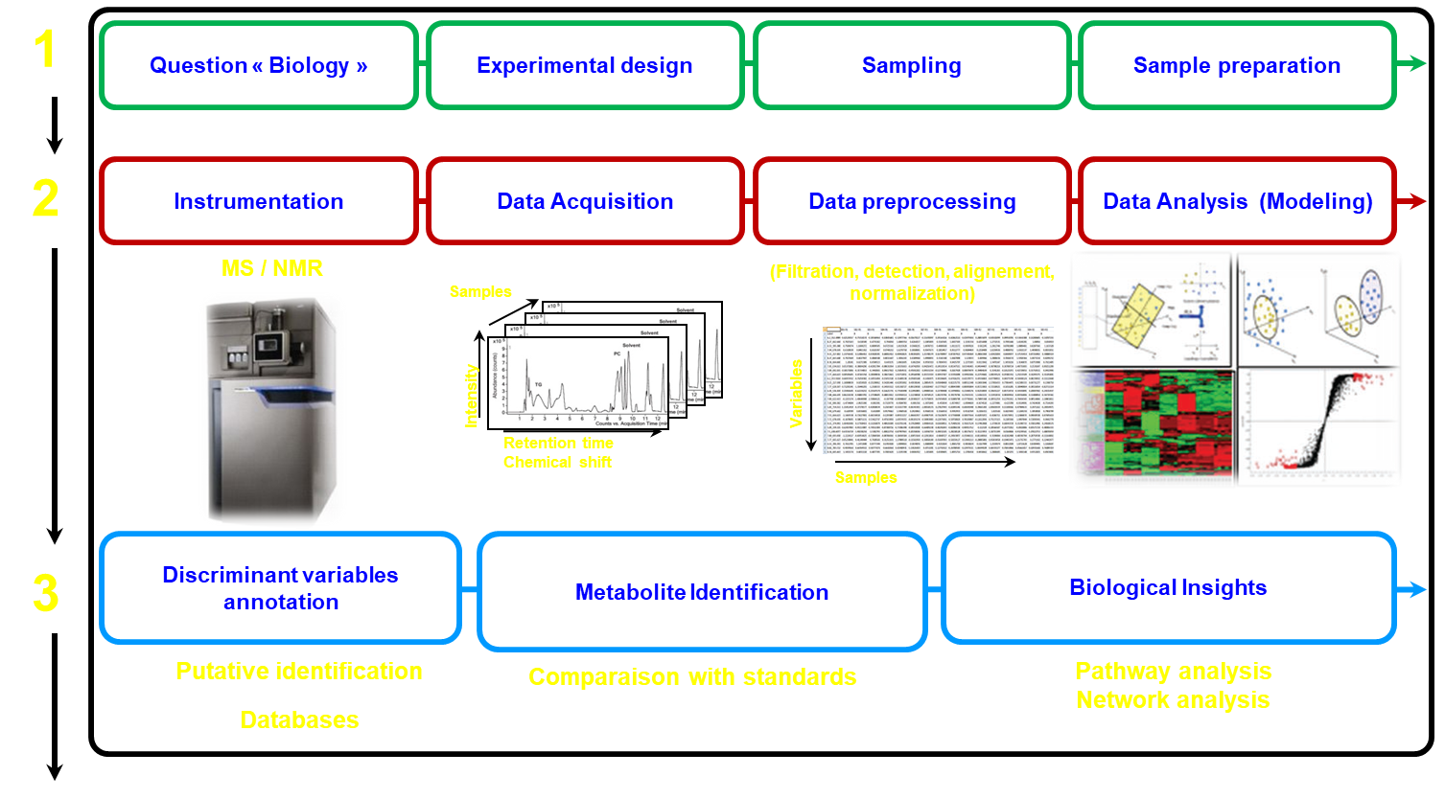
Metabolomics worflow
Tebani, A. IJMS. 2016, 17, 1167

Slide 13
PREPROCESSING

Slide 14
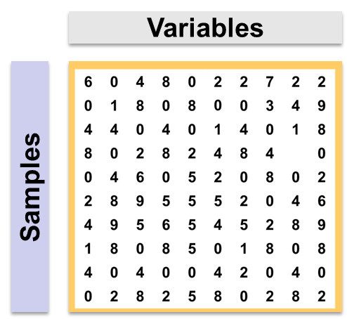
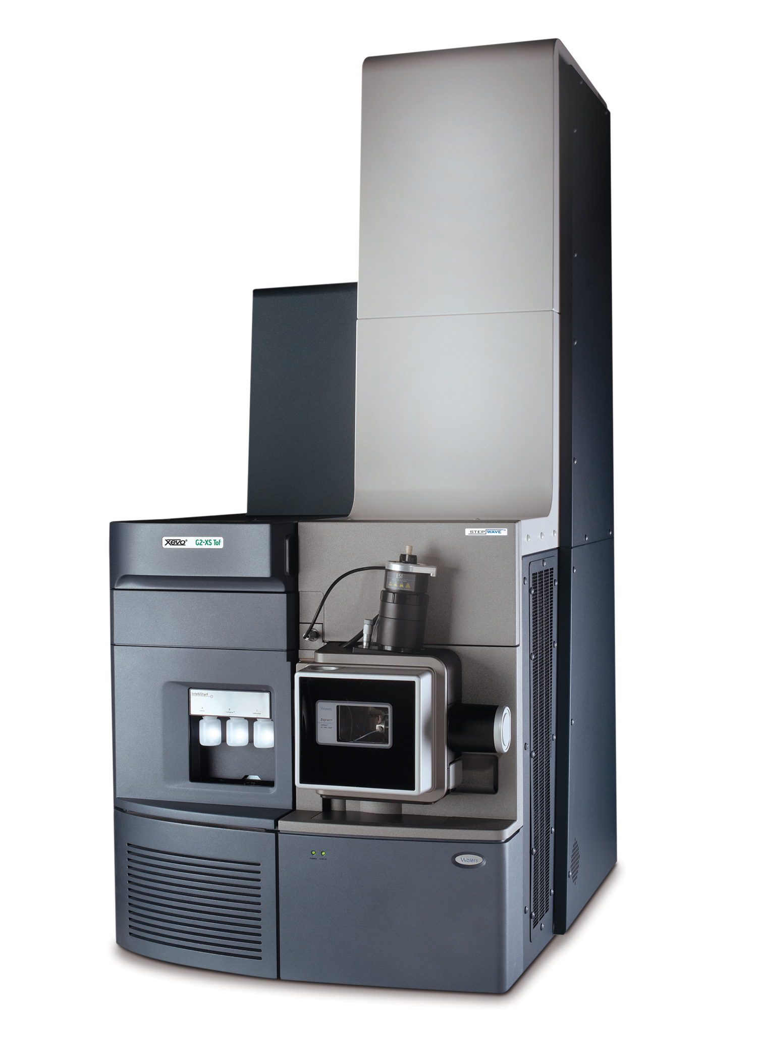
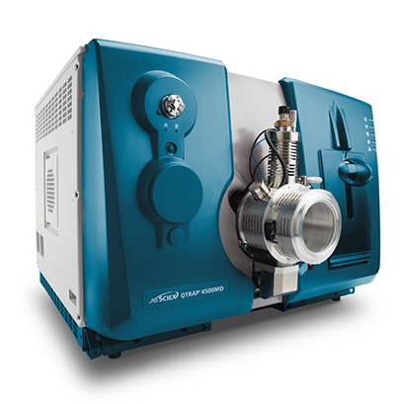
Data processing
Signal
Data

Slide 15
Data processing

Slide 16
Data processing
Direct MS Analysis
Data conversion
Noise filtering
Baseline correction
Peak detection
Hyphenated MS Analysis
Data conversion (Proteowizard)
Peak detection and integration
Alignement
Gap-filling

Slide 17
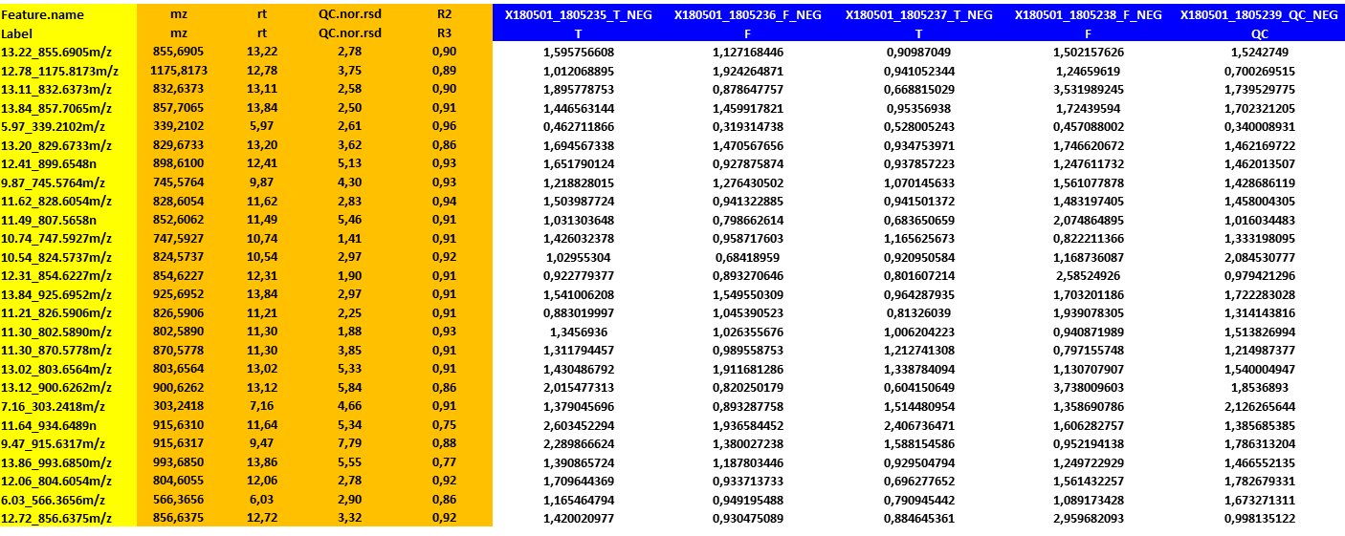
Output data structure
Feature Identifier
Sample identifier
Feature intensity

Slide 18
Data processing softwares
Spicer, R., Salek, R.M., Moreno, P. et al. Metabolomics (2017) 13: 106

Slide 19
GETTING DATA READY

Slide 20
Data Analysis
Input
A matrix containing numerical values
Concentrations (Targeted)
Peak intensities (Untargeted)
Meta-data
Class labels, experimental factors
Output
Discriminant features
Clustering patterns
Biological Inference
Biomarkers
Predictive models

Slide 21
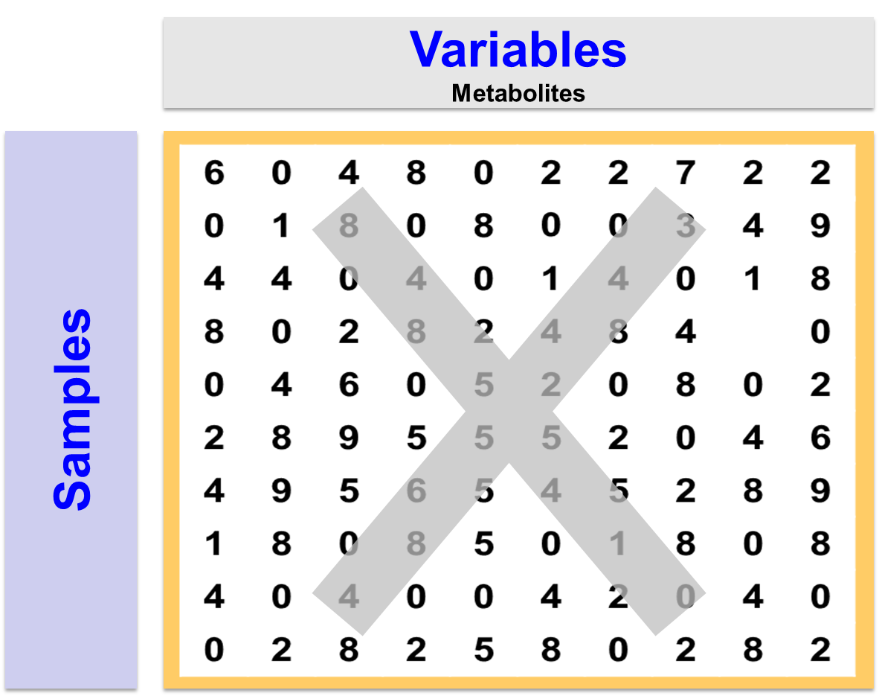
Data Analysis

Slide 22
Data Analysis
Variables
Metabolites
Samples
Information
+
Noise

Slide 23
Data Analysis / Data cleaning
Remove as much as possible noise
Extract as much as possible information

Slide 24

Data Analysis / Data cleaning
Data cleaning
Missing values imputation
Filtering (Min, IQR, RSD, CV, R2 …)
Normalization

Slide 25

Data Analysis / Data cleaning
Cut-off

Slide 26
Data Analysis / Data cleaning
Missing values imputation
Replace by
mean
median
min
…
k-nearest neighbour (KNN)
PCA based methods
…
Wolfram et al. Bioinformatics, Volume 23, Issue 9, 1 May 2007, Pages 1164–1167

Slide 27
Data Analysis / Normalization
Sample normalization (row-wise)
To remove systematic variation between experimental conditions unrelated to the biological differences (i.e. dilutions, mass)
Feature normalization (column-wise)
To bring variances of all features close to equal

Slide 28
Data Analysis / Normalization
Sample normalization (row-wise)
Total signal, sum of signals
Reference compound: Internal standards, endogenous metabolites
Reference sample: QCs, Controls…
Feature normalization (column-wise)
Log transformation
Scaling
van den Berg et al. BMC Genomics. 2006

Slide 29
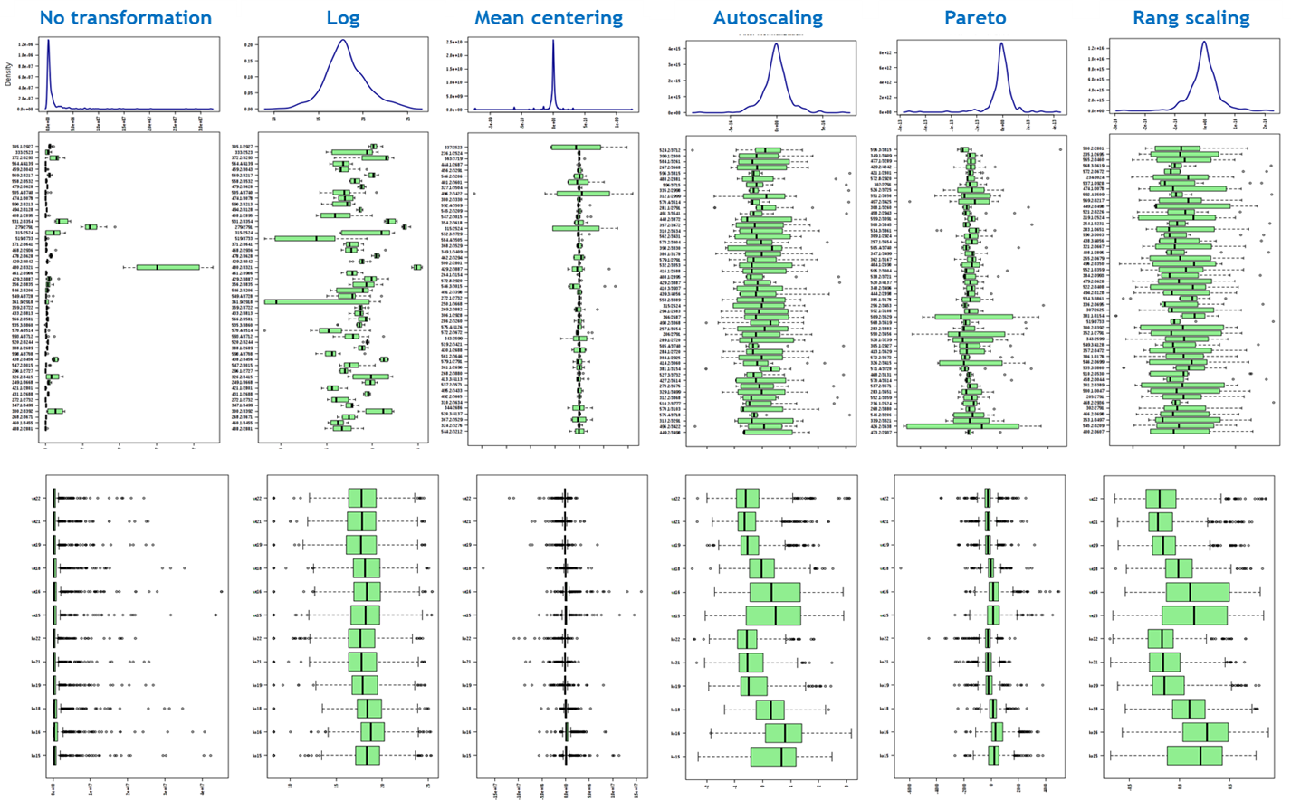
Data Analysis / Normalization
Variables
Samples

Slide 30
Data Analysis / Normalization

Slide 31
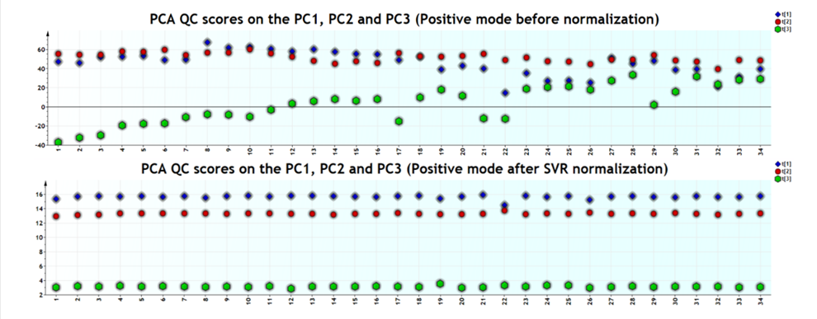
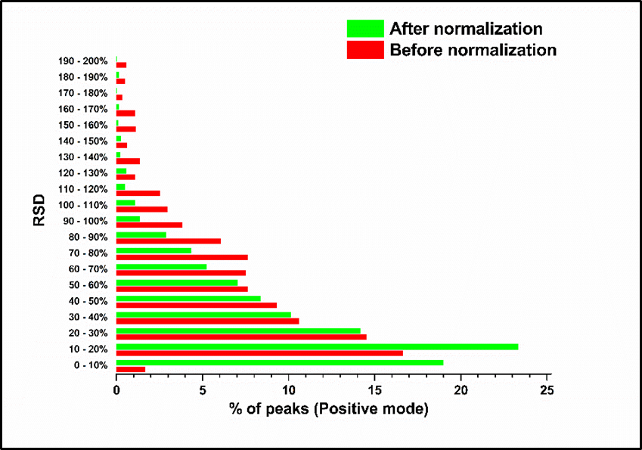
Data Analysis / Batch effect

Slide 32
Outline
Part I - Getting the biological information
Experimental Design
Data Generation
Omics data
Preprocessing
Data cleaning
Part II – Machine Learning and Data Analysis
Univariate vs Multivariate
What is meachine learning
Unsupervized learning
Supervized learning
Key Steps of Learning and best practice

Slide 33
Data Analysis / Univariate analysis
t-tests
 | Independent Samples | Related Samples
Parametric | Independent samples t-test | Paired samples t-test
Non-parametric | Mann-Whitney U-Test | Wilcoxon test
Parametric t-tests
Student's t-test: testing two populations have normal distributions and with equal variances
Welch's t-test is designed for unequal variances

Slide 34
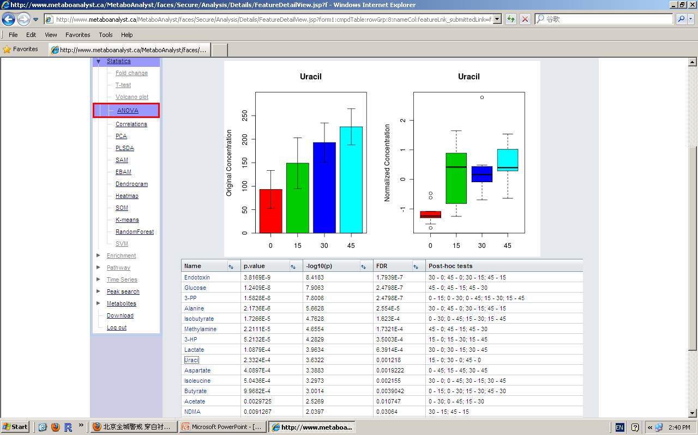
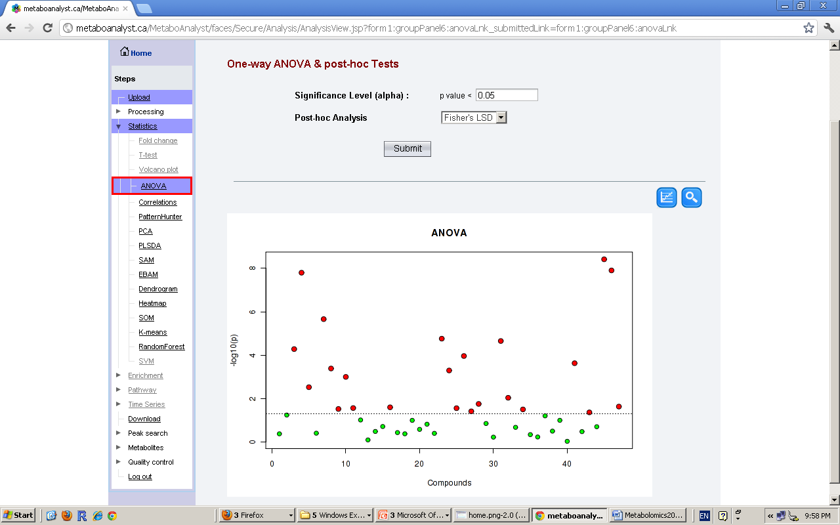
Data Analysis / Univariate analysis

Slide 35
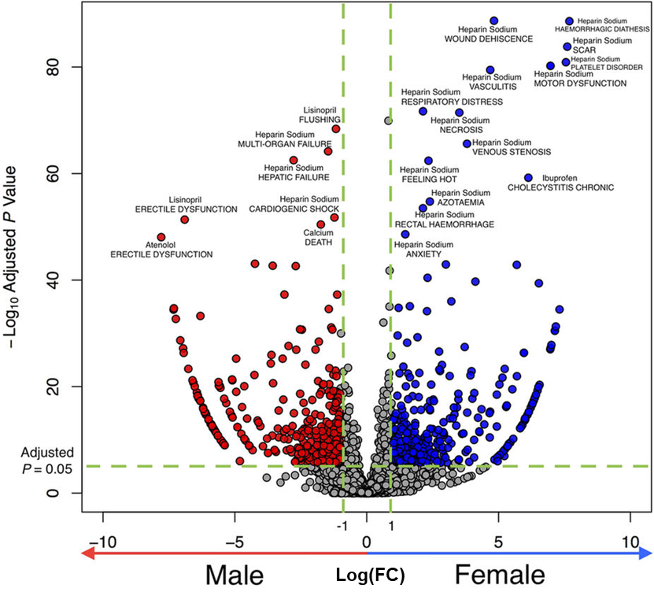
Data Analysis / Univariate analysis
Y Yu et al. Scientific reports, 2016

Slide 36
Data Analysis
Tow main objectives
Descriptive data analysis (Unsupervised learning)
Mining massive datasets to discover hidden
data structures
hidden relationships
patterns, trends and clusters
outliers
Dimension reduction
Predictive data analysis (Supervised learning)
Building models for specific tasks using training datasets
regression
classification,
pattern recognition
machine learning tasks
Assessing the predictive accuracy of the models using new datasets
X
X
Y

Slide 37
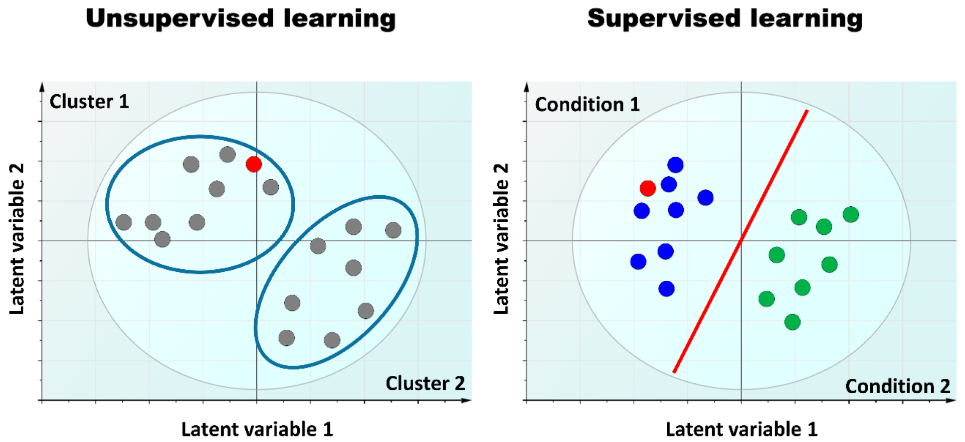
Data Analysis
Tebani A et.al. Int J Mol Sci. 2016 Sep; 17(9): 1.

Slide 38
Data Analysis / Unsupervised learning
Clustering
Organize the 1000s of variables into blocks
Variables in each block are more homogenous
Key parameter: similarities (Distance, Spearman, Pearson …)
Similarity between samples - Similarity between clusters
Visualization using Heatmaps
K-means
Hierarchical Methods
Dimension reduction
Reduce the high-dimensional data
1000s into low-dimensions (Latent variables)
Principal component analysis (PCA)

Slide 39
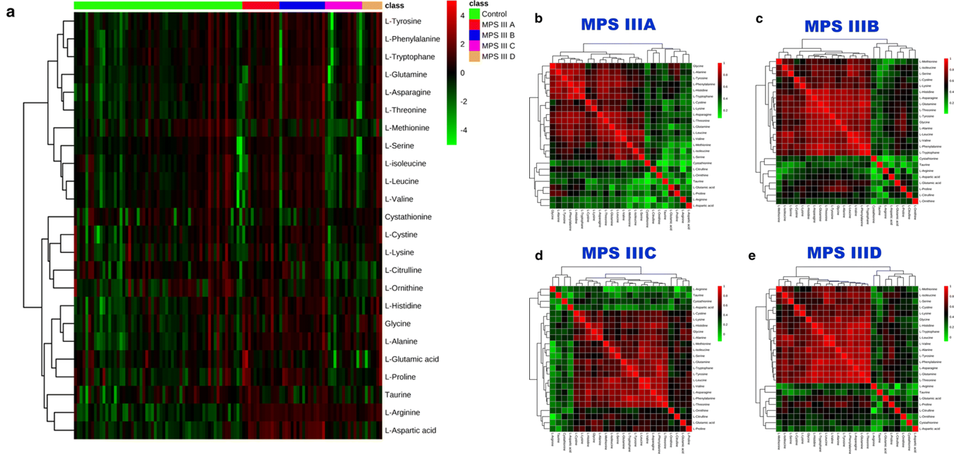
Data Analysis / Unsupervised learning
Correlation Heatmap
Tebani A et.al. JTRM 2018

Slide 40
Data Analysis / Unsupervised learning
PRINICPAL COMPONENT ANALYSIS (PCA)
It is always a matter of perspective!!

Slide 41
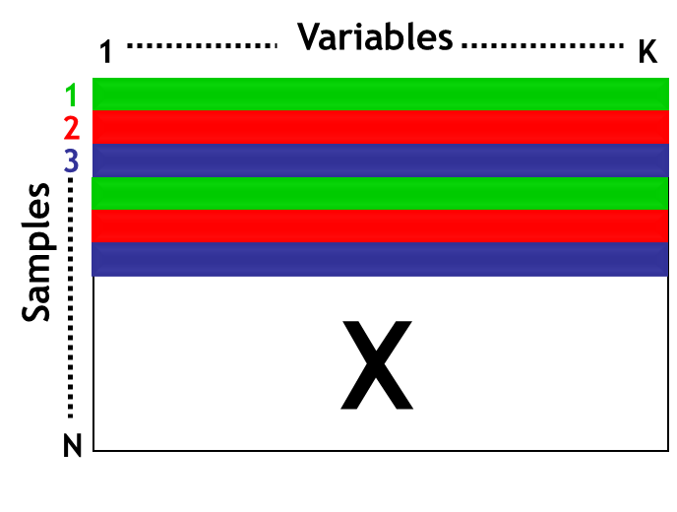
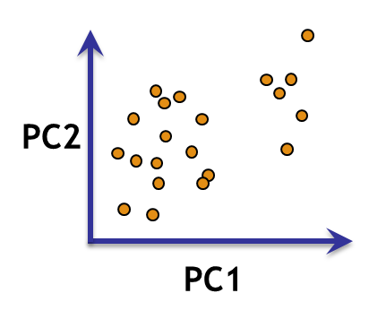
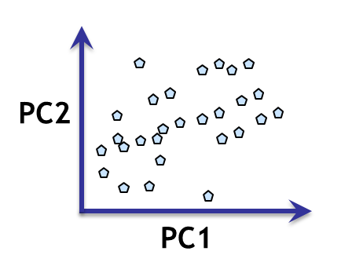
Data Analysis / Unsupervised learning (PCA)
“Scores”
Summarises the variation
in the object direction
“Loadings”
Summarises the variation in the variable direction

Slide 42
Data Analysis / Unsupervised learning (PCA)
2nd principal component follows largest variation which is perpendicular (orthogonal) to 1st component
1st principal component follows largest variation in data
PC1
PC2
Loading = weight of original variable in a principal component
Score = distance from projection of a point on a component to origin

Slide 43
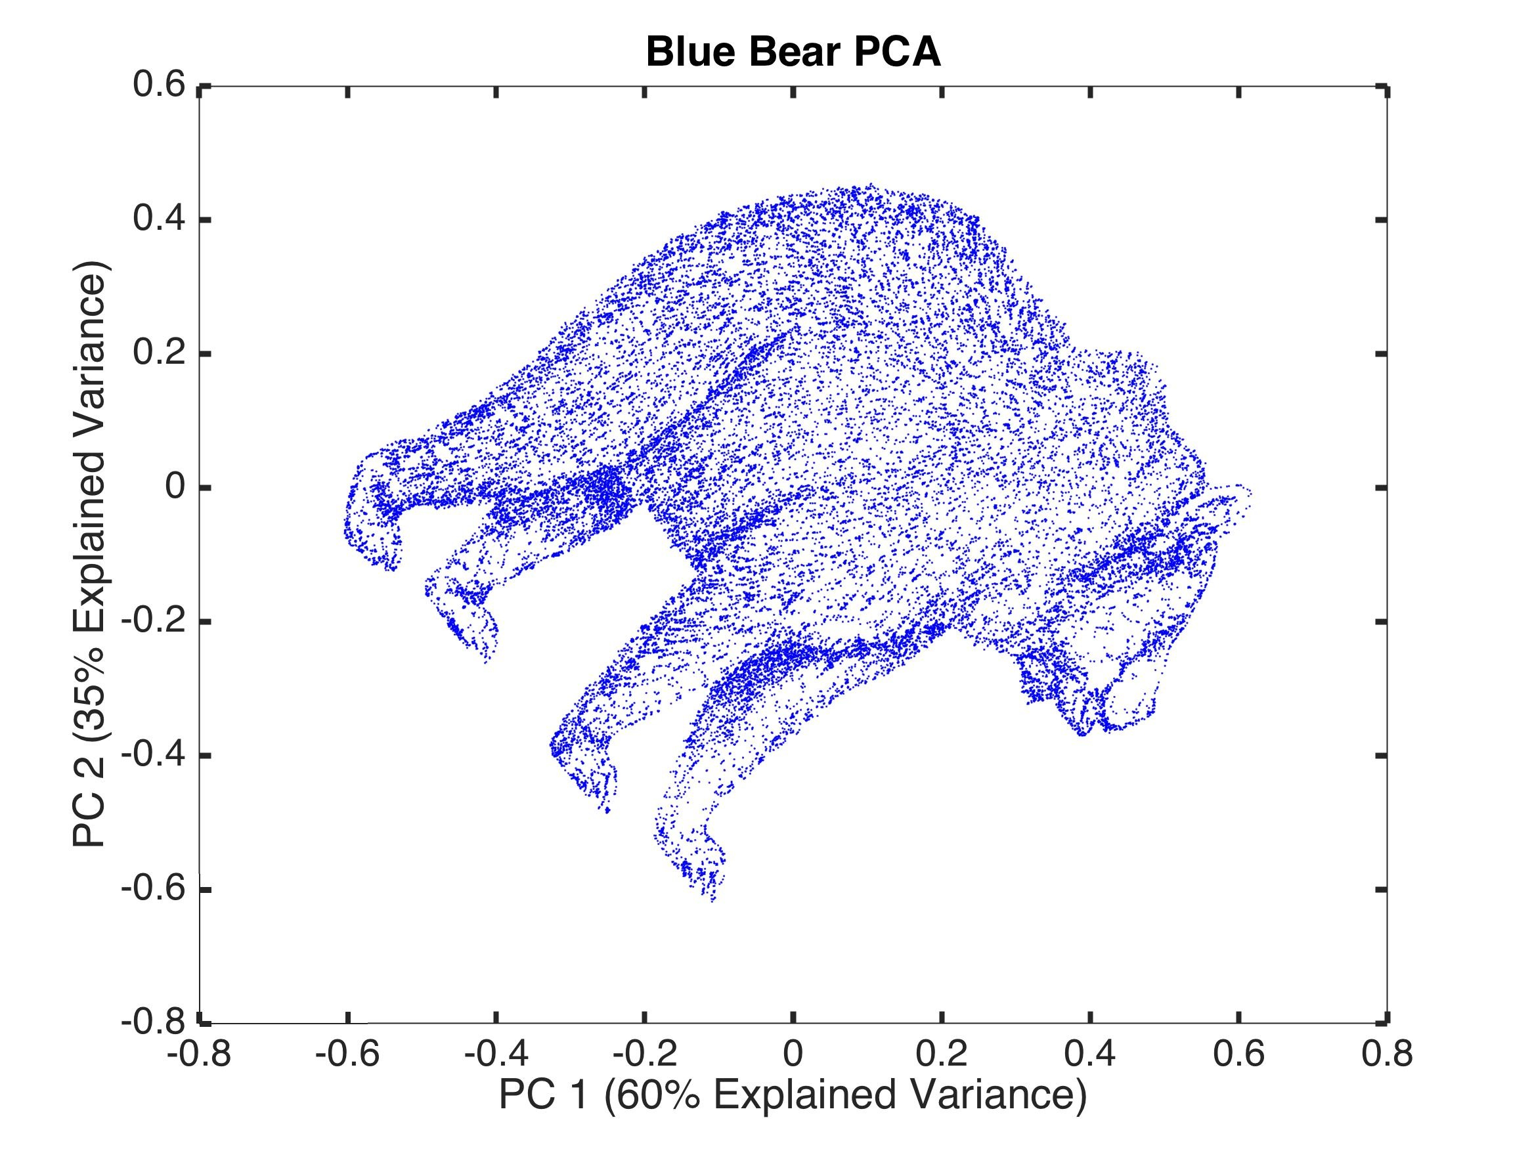
Data Analysis / Unsupervised learning (PCA)

Slide 44
Data Analysis / Unsupervised learning (PCA)
PCA models directions of greatest variation in data
PCA performs dimension reduction
Scores describe variation between objects
Strong outliers are visible
Loadings describe importance of variables
Residuals describe unmodelled variation
Limits: based on orthogonality not on the independence of the components

Slide 45
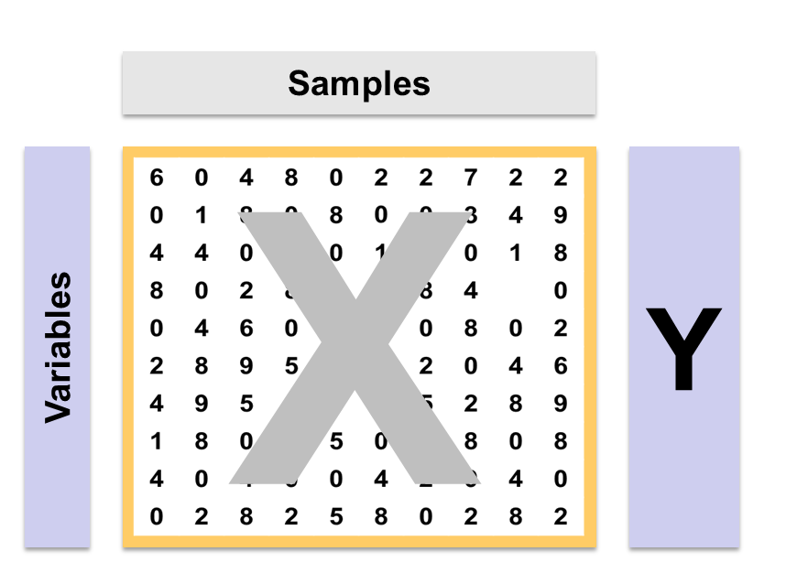

Data Analysis / Supervised learning
f(x) = y
Supervised = algorithm does know true answer
Attempt to find rule which predicts output for given input
Two cases
Classification - output is discrete (Class label)
Regression - output is continuous

Slide 46
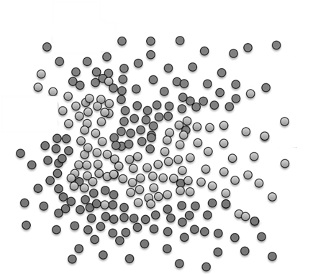
Data Analysis / Supervised learning

Slide 47
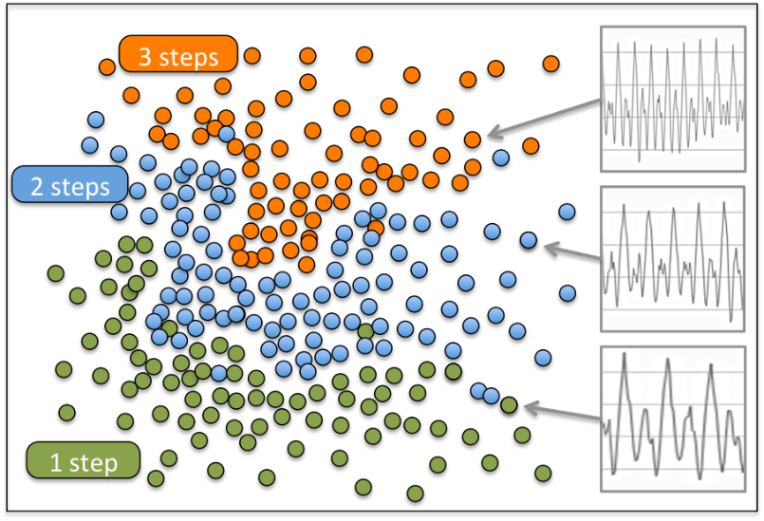
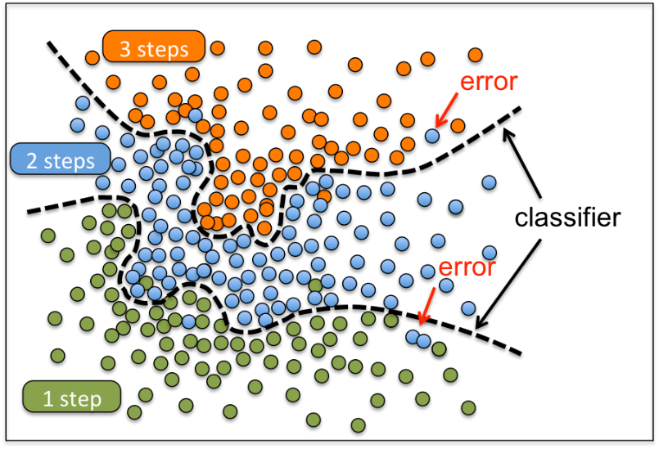
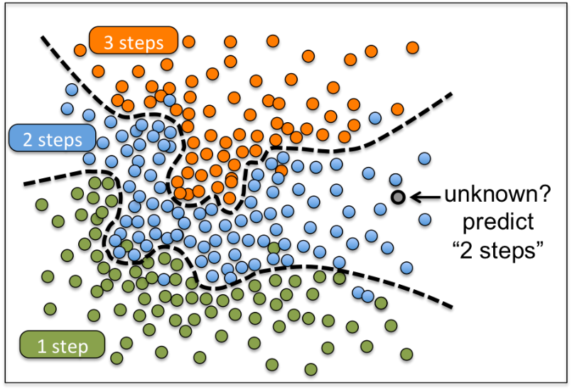
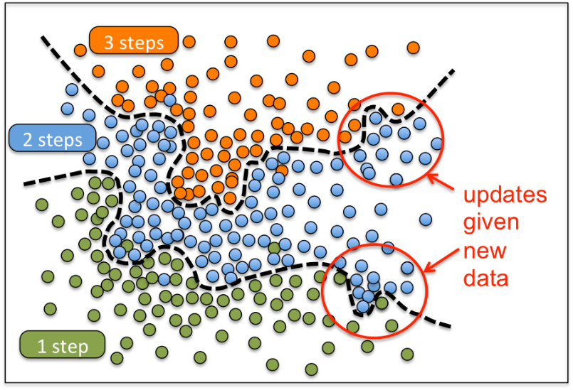
Data Analysis / Supervised learning
1
2
3
4
https://jawbone.com/blog/classifying-steps-machine-learning/

Slide 48
Data Analysis / Supervised learning
Linear Discriminant Analysis
Partial Least Squares
k-Nearest Neighbors
Random Forest
Support Vector Machines
Bayesian networks
Neural Networks
… name it
https://jawbone.com/blog/classifying-steps-machine-learning/

Slide 49
Data Analysis / Supervised learning (PLS)
Partial Least Squares models directions of greatest variation in data
Regression technique - relates X to Y
Projection technique
Good when
More variables than samples
Many highly correlated variables
More than one Y variable
Missing data
Widely used in metabonomics

Slide 50
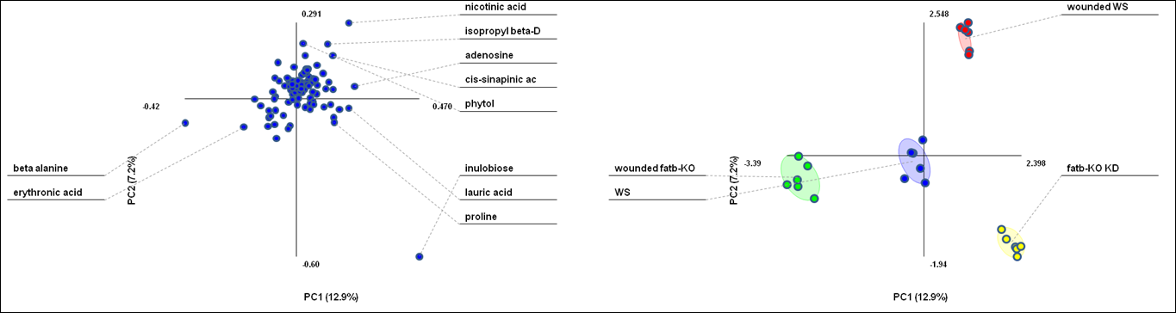
Data Analysis / Supervised learning (PLSDA)
PLS-DA Loadings | PLS-DA Scores
Information about variables responsible for class separation Ranking discriminant features | Information about class separation

Slide 51
Data Analysis / Supervised learning
Model validation
A statistically valid model
Has good fit to the data
Is predictive of new data
Validation methods
Training set / Testing set
Cross-validation
Permutation test

Slide 52
Data Analysis / Supervised learning
Training dataset: a set of examples used to build the predictive model
Validation dataset: a set of examples used to refine the model parameters and estimate the error.
Test dataset: used only to evaluate the predictive performance of the model. They are never used during the learning or testing process.
Tebani et al. Int J Mol Sci. 2016 Sep; 17(9): 1.

Slide 53
Data Analysis / Supervised learning
Training set
Test set
1
2
3
4
1
2
3
4
5
6
7
8
Validation: split the data
Training set – to build the model
Test set – to validate the model
5
6
7
8
Build model
Predict test set

Slide 54
Data Analysis / Supervised learning
Cross-Validation
Divide the dataset into k parts
Use k-1 for training and 1 for testing
Determine an optimization metric (RMSE, Accuracy, ROC, …)
Iterate
Training set
Test set

Slide 55
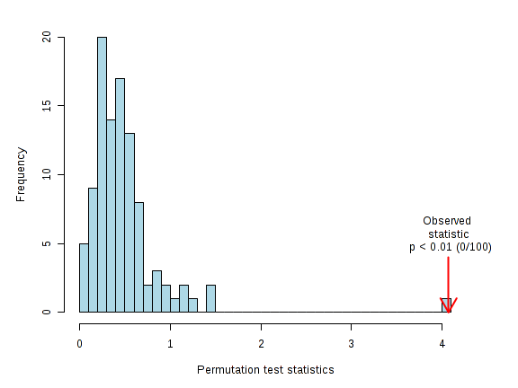
Omics Data Analysis / Supervised learning
Permutation test

Slide 56
Take home message
Unsupervised Methods
Data is “unlabeled”
PCA or clustering
Many other techniques
Supervised Methods
Data is labeled
Classification or regression
Enhance separation
Statistical Significance
Univariate statistics is useful
Supervised methods always generate group separation
Permutation test checks artifactual clustering

